Slide 1
SOA Exam FM
Module 3 – Section 2
Outstanding Balance (More Examples)

Slide 2

$$Outstanding Balance Examples$$
1) A loan of 500,000 at an annual effective interest rate of 6% is repaid with annual payments. The first payment is 20,000 and subsequent payments are 5000 more than their preceding payments. Determine the outstanding balance immediately after the 10th payment.

Slide 3





$$Outstanding Balance Examples$$
1) A loan of 500,000 at an annual effective interest rate of 6% is repaid with annual payments. The first payment is 20,000 and subsequent payments are 5000 more than their preceding payments. Determine the outstanding balance immediately after the 10th payment.
$$20000$$
$$25000$$
$$⋯$$
$$⋯$$
$$1$$
$$2$$
$$10$$
$$L=500000$$

Slide 4

$$Outstanding Balance Examples$$
1) A loan of 500,000 at an annual effective interest rate of 6% is repaid with annual payments. The first payment is 20,000 and subsequent payments are 5000 more than their preceding payments. Determine the outstanding balance immediately after the 10th payment.
$$20000$$
$$25000$$
$$⋯$$
$$65000$$
$$⋯$$
$$1$$
$$2$$
$$10$$
$$L=500000$$

Slide 5

$$Outstanding Balance Examples$$
1) A loan of 500,000 at an annual effective interest rate of 6% is repaid with annual payments. The first payment is 20,000 and subsequent payments are 5000 more than their preceding payments. Determine the outstanding balance immediately after the 10th payment.
$$20000$$
$$25000$$
$$⋯$$
$$65000$$
$$⋯$$
$$1$$
$$2$$
$$10$$
$$L=500000$$
$$B_{10}$$

Slide 6

$$Outstanding Balance Examples$$
1) A loan of 500,000 at an annual effective interest rate of 6% is repaid with annual payments. The first payment is 20,000 and subsequent payments are 5000 more than their preceding payments. Determine the outstanding balance immediately after the 10th payment.
$$20000$$
$$25000$$
$$⋯$$
$$65000$$
$$⋯$$
$$1$$
$$2$$
$$10$$
$$L=500000$$
$$I_{1}=500000∙0.06$$

Slide 7

$$Outstanding Balance Examples$$
1) A loan of 500,000 at an annual effective interest rate of 6% is repaid with annual payments. The first payment is 20,000 and subsequent payments are 5000 more than their preceding payments. Determine the outstanding balance immediately after the 10th payment.
$$20000$$
$$25000$$
$$⋯$$
$$65000$$
$$⋯$$
$$1$$
$$2$$
$$10$$
$$L=500000$$
$$I_{1}=30000$$

Slide 8

$$Outstanding Balance Examples$$
1) A loan of 500,000 at an annual effective interest rate of 6% is repaid with annual payments. The first payment is 20,000 and subsequent payments are 5000 more than their preceding payments. Determine the outstanding balance immediately after the 10th payment.
$$20000$$
$$25000$$
$$⋯$$
$$65000$$
$$⋯$$
$$1$$
$$2$$
$$10$$
$$L=500000$$
$$I_{1}=30000$$
$$C_{1}=20000$$

Slide 9

$$Outstanding Balance Examples$$
1) A loan of 500,000 at an annual effective interest rate of 6% is repaid with annual payments. The first payment is 20,000 and subsequent payments are 5000 more than their preceding payments. Determine the outstanding balance immediately after the 10th payment.
$$20000$$
$$25000$$
$$⋯$$
$$65000$$
$$⋯$$
$$1$$
$$2$$
$$10$$
$$L=500000$$
$$I_{1}=30000$$
$$C_{1}=20000$$
$$∴P_{1}=−10000$$

Slide 10

$$Outstanding Balance Examples$$
1) A loan of 500,000 at an annual effective interest rate of 6% is repaid with annual payments. The first payment is 20,000 and subsequent payments are 5000 more than their preceding payments. Determine the outstanding balance immediately after the 10th payment.
$$20000$$
$$25000$$
$$⋯$$
$$65000$$
$$⋯$$
$$1$$
$$2$$
$$10$$
$$L=500000$$
$$I_{1}=30000$$
$$C_{1}=20000$$
$$∴P_{1}=−10000$$
$$B_{1}=510000$$

Slide 11
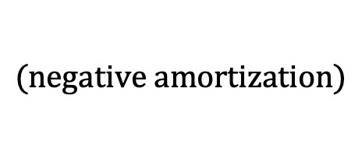
$$Outstanding Balance Examples$$
1) A loan of 500,000 at an annual effective interest rate of 6% is repaid with annual payments. The first payment is 20,000 and subsequent payments are 5000 more than their preceding payments. Determine the outstanding balance immediately after the 10th payment.
$$20000$$
$$25000$$
$$⋯$$
$$65000$$
$$⋯$$
$$1$$
$$2$$
$$10$$
$$L=500000$$
$$I_{1}=30000$$
$$C_{1}=20000$$
$$∴P_{1}=−10000$$
$$B_{1}=510000$$
$$(negative amortization)$$

Slide 12

$$Outstanding Balance Examples$$
1) A loan of 500,000 at an annual effective interest rate of 6% is repaid with annual payments. The first payment is 20,000 and subsequent payments are 5000 more than their preceding payments. Determine the outstanding balance immediately after the 10th payment.
$$20000$$
$$25000$$
$$⋯$$
$$65000$$
$$⋯$$
$$1$$
$$2$$
$$10$$
$$L=500000$$
$$B_{1}=510000$$

Slide 13

$$Outstanding Balance Examples$$
1) A loan of 500,000 at an annual effective interest rate of 6% is repaid with annual payments. The first payment is 20,000 and subsequent payments are 5000 more than their preceding payments. Determine the outstanding balance immediately after the 10th payment.
$$20000$$
$$25000$$
$$⋯$$
$$65000$$
$$⋯$$
$$1$$
$$2$$
$$10$$
$$L=500000$$
$$B_{1}=510000$$
$$B_{2}=510000∙\left(1.06\right)−25000$$

Slide 14

$$Outstanding Balance Examples$$
1) A loan of 500,000 at an annual effective interest rate of 6% is repaid with annual payments. The first payment is 20,000 and subsequent payments are 5000 more than their preceding payments. Determine the outstanding balance immediately after the 10th payment.
$$20000$$
$$25000$$
$$⋯$$
$$65000$$
$$⋯$$
$$1$$
$$2$$
$$10$$
$$L=500000$$
$$B_{1}=510000$$
$$B_{2}=510000∙\left(1.06\right)−25000$$
$$=515600$$

Slide 15

$$Outstanding Balance Examples$$
1) A loan of 500,000 at an annual effective interest rate of 6% is repaid with annual payments. The first payment is 20,000 and subsequent payments are 5000 more than their preceding payments. Determine the outstanding balance immediately after the 10th payment.
$$20000$$
$$25000$$
$$⋯$$
$$65000$$
$$⋯$$
$$1$$
$$2$$
$$10$$
$$L=500000$$
$$B_{1}=510000$$
$$B_{2}=510000∙\left(1.06\right)−25000$$
$$=515600$$
$$B_{3}=515600∙\left(1.06\right)−30000$$

Slide 16

$$Outstanding Balance Examples$$
1) A loan of 500,000 at an annual effective interest rate of 6% is repaid with annual payments. The first payment is 20,000 and subsequent payments are 5000 more than their preceding payments. Determine the outstanding balance immediately after the 10th payment.
$$20000$$
$$25000$$
$$⋯$$
$$65000$$
$$⋯$$
$$1$$
$$2$$
$$10$$
$$L=500000$$
$$B_{1}=510000$$
$$B_{2}=510000∙\left(1.06\right)−25000$$
$$=515600$$
$$B_{3}=515600∙\left(1.06\right)−30000$$
$$=516536$$

Slide 17

$$Outstanding Balance Examples$$
1) A loan of 500,000 at an annual effective interest rate of 6% is repaid with annual payments. The first payment is 20,000 and subsequent payments are 5000 more than their preceding payments. Determine the outstanding balance immediately after the 10th payment.
$$20000$$
$$25000$$
$$⋯$$
$$65000$$
$$⋯$$
$$1$$
$$2$$
$$10$$
$$L=500000$$
$$B_{1}=510000$$
$$B_{2}=510000∙\left(1.06\right)−25000$$
$$=515600$$
$$B_{3}=515600∙\left(1.06\right)−30000$$
$$=516536$$
$$B_{4}=516536∙\left(1.06\right)−35000$$

Slide 18

$$Outstanding Balance Examples$$
1) A loan of 500,000 at an annual effective interest rate of 6% is repaid with annual payments. The first payment is 20,000 and subsequent payments are 5000 more than their preceding payments. Determine the outstanding balance immediately after the 10th payment.
$$20000$$
$$25000$$
$$⋯$$
$$65000$$
$$⋯$$
$$1$$
$$2$$
$$10$$
$$L=500000$$
$$B_{1}=510000$$
$$B_{2}=510000∙\left(1.06\right)−25000$$
$$=515600$$
$$B_{3}=515600∙\left(1.06\right)−30000$$
$$=516536$$
$$B_{4}=516536∙\left(1.06\right)−35000$$
$$=512528.16$$

Slide 19
$$Outstanding Balance Examples$$
1) A loan of 500,000 at an annual effective interest rate of 6% is repaid with annual payments. The first payment is 20,000 and subsequent payments are 5000 more than their preceding payments. Determine the outstanding balance immediately after the 10th payment.
$$20000$$
$$25000$$
$$⋯$$
$$65000$$
$$⋯$$
$$1$$
$$2$$
$$10$$
$$L=500000$$
$$B_{10}$$

Slide 20

$$Outstanding Balance Examples$$
1) A loan of 500,000 at an annual effective interest rate of 6% is repaid with annual payments. The first payment is 20,000 and subsequent payments are 5000 more than their preceding payments. Determine the outstanding balance immediately after the 10th payment.
$$20000$$
$$25000$$
$$⋯$$
$$65000$$
$$⋯$$
$$1$$
$$2$$
$$10$$
$$L=500000$$
$$B_{10}$$
$$(Retrospective)$$

Slide 21
$$Outstanding Balance Examples$$
1) A loan of 500,000 at an annual effective interest rate of 6% is repaid with annual payments. The first payment is 20,000 and subsequent payments are 5000 more than their preceding payments. Determine the outstanding balance immediately after the 10th payment.
$$20000$$
$$25000$$
$$⋯$$
$$65000$$
$$⋯$$
$$1$$
$$2$$
$$10$$
$$L=500000$$
$$B_{10}$$
$$(Retrospective)$$
$$B_{10}=500000{(1.06)}^{10}−15000s_{\overline{10}|}−5000{(Is)}_{\overline{10}|}$$

Slide 22
$$Outstanding Balance Examples$$
1) A loan of 500,000 at an annual effective interest rate of 6% is repaid with annual payments. The first payment is 20,000 and subsequent payments are 5000 more than their preceding payments. Determine the outstanding balance immediately after the 10th payment.
$$20000$$
$$25000$$
$$⋯$$
$$65000$$
$$⋯$$
$$1$$
$$2$$
$$10$$
$$L=500000$$
$$B_{10}$$
$$(Retrospective)$$
$$B_{10}=500000{(1.06)}^{10}−15000s_{\overline{10}|}−5000{(Is)}_{\overline{10}|}$$
$$B_{10}=500000{(1.06)}^{10}−20000s_{\overline{10}|}−5000{(Is)}_{\overline{9}|}$$

Slide 23

$$Outstanding Balance Examples$$
1) A loan of 500,000 at an annual effective interest rate of 6% is repaid with annual payments. The first payment is 20,000 and subsequent payments are 5000 more than their preceding payments. Determine the outstanding balance immediately after the 10th payment.
$$20000$$
$$25000$$
$$⋯$$
$$65000$$
$$⋯$$
$$1$$
$$2$$
$$10$$
$$L=500000$$
$$B_{10}$$
$$(Retrospective)$$
$$B_{10}=500000{(1.06)}^{10}−15000s_{\overline{10}|}−5000{(Is)}_{\overline{10}|}$$
$$B_{10}=500000{(1.06)}^{10}−20000s_{\overline{10}|}−5000{(Is)}_{\overline{9}|}$$
$$B_{10}=366,741.70$$

Slide 24
$$Outstanding Balance Examples$$
2) A 10-year loan at a quarterly effective interest rate of 2% is repaid with quarterly payments. The first payment is 1000 and subsequent payments are 2% less than their preceding payments. Determine the outstanding balance immediately after the 25th payment.

Slide 25








$$Outstanding Balance Examples$$
2) A 10-year loan at a quarterly effective interest rate of 2% is repaid with quarterly payments. The first payment is 1000 and subsequent payments are 2% less than their preceding payments. Determine the outstanding balance immediately after the 25th payment.
$$1000$$
$$1000(0.98)$$
$$⋯$$
$$1000{(0.98)}^{24}$$
$$⋯$$
$$⋯$$
$$⋯$$
$$1$$
$$2$$
$$25$$
$$L$$
$$B_{25}$$

Slide 26









$$Outstanding Balance Examples$$
2) A 10-year loan at a quarterly effective interest rate of 2% is repaid with quarterly payments. The first payment is 1000 and subsequent payments are 2% less than their preceding payments. Determine the outstanding balance immediately after the 25th payment.
$$1000{(0.98)}^{25}$$
$$1000{(0.98)}^{26}$$
$$1000{(0.98)}^{39}$$
$$⋯$$
$$⋯$$
$$⋯$$
$$⋯$$
$$25$$
$$26$$
$$27$$
$$40$$
$$B_{25}$$
$$(Prospective)$$

Slide 27
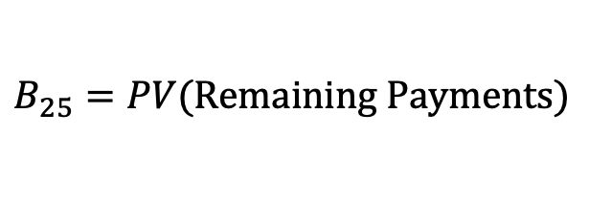
$$Outstanding Balance Examples$$
2) A 10-year loan at a quarterly effective interest rate of 2% is repaid with quarterly payments. The first payment is 1000 and subsequent payments are 2% less than their preceding payments. Determine the outstanding balance immediately after the 25th payment.
$$1000{(0.98)}^{25}$$
$$1000{(0.98)}^{26}$$
$$1000{(0.98)}^{39}$$
$$⋯$$
$$⋯$$
$$⋯$$
$$⋯$$
$$25$$
$$26$$
$$27$$
$$40$$
$$B_{25}=PV(Remaining Payments)$$

Slide 28
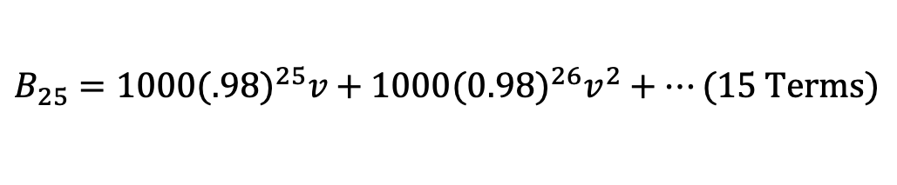
$$Outstanding Balance Examples$$
2) A 10-year loan at a quarterly effective interest rate of 2% is repaid with quarterly payments. The first payment is 1000 and subsequent payments are 2% less than their preceding payments. Determine the outstanding balance immediately after the 25th payment.
$$1000{(0.98)}^{25}$$
$$1000{(0.98)}^{26}$$
$$1000{(0.98)}^{39}$$
$$⋯$$
$$⋯$$
$$⋯$$
$$⋯$$
$$25$$
$$26$$
$$27$$
$$40$$
$$B_{25}=1000{(.98)}^{25}v+1000{(0.98)}^{26}v^{2}+⋯(15 Terms)$$

Slide 29
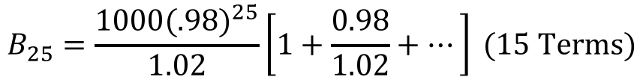
$$Outstanding Balance Examples$$
2) A 10-year loan at a quarterly effective interest rate of 2% is repaid with quarterly payments. The first payment is 1000 and subsequent payments are 2% less than their preceding payments. Determine the outstanding balance immediately after the 25th payment.
$$1000{(0.98)}^{25}$$
$$1000{(0.98)}^{26}$$
$$1000{(0.98)}^{39}$$
$$⋯$$
$$⋯$$
$$⋯$$
$$⋯$$
$$25$$
$$26$$
$$27$$
$$40$$
$$B_{25}=1000{(.98)}^{25}v+1000{(0.98)}^{26}v^{2}+⋯(15 Terms)$$
$$B_{25}=\frac{1000{(.98)}^{25}}{1.02}\left[1+\frac{0.98}{1.02}+⋯\right] (15 Terms)$$

Slide 30
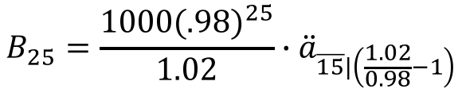
$$Outstanding Balance Examples$$
2) A 10-year loan at a quarterly effective interest rate of 2% is repaid with quarterly payments. The first payment is 1000 and subsequent payments are 2% less than their preceding payments. Determine the outstanding balance immediately after the 25th payment.
$$1000{(0.98)}^{25}$$
$$1000{(0.98)}^{26}$$
$$1000{(0.98)}^{39}$$
$$⋯$$
$$⋯$$
$$⋯$$
$$⋯$$
$$25$$
$$26$$
$$27$$
$$40$$
$$B_{25}=1000{(.98)}^{25}v+1000{(0.98)}^{26}v^{2}+⋯(15 Terms)$$
$$B_{25}=\frac{1000{(.98)}^{25}}{1.02}\left[1+\frac{0.98}{1.02}+⋯\right] (15 Terms)$$
$$B_{25}=\frac{1000{(.98)}^{25}}{1.02}∙{\ddot{a}}_{\overline{15}|\left(\frac{1.02}{0.98}−1\right)}$$

Slide 31

$$Outstanding Balance Examples$$
2) A 10-year loan at a quarterly effective interest rate of 2% is repaid with quarterly payments. The first payment is 1000 and subsequent payments are 2% less than their preceding payments. Determine the outstanding balance immediately after the 25th payment.
$$1000{(0.98)}^{25}$$
$$1000{(0.98)}^{26}$$
$$1000{(0.98)}^{39}$$
$$⋯$$
$$⋯$$
$$⋯$$
$$⋯$$
$$25$$
$$26$$
$$27$$
$$40$$
$$B_{25}=1000{(.98)}^{25}v+1000{(0.98)}^{26}v^{2}+⋯(15 Terms)$$
$$B_{25}=\frac{1000{(.98)}^{25}}{1.02}\left[1+\frac{0.98}{1.02}+⋯\right] (15 Terms)$$
$$B_{25}=\frac{1000{(.98)}^{25}}{1.02}∙{\ddot{a}}_{\overline{15}|\left(\frac{1.02}{0.98}−1\right)}$$
$$=6807.57$$

